Slide 1
Heap Queue (heapq) in Python
DVT101 – Lecture 31
- By Dataverse Tutorials

Slide 2
What is a Heap Queue?
Meaning of priority queue
Min-heap vs max-heap idea
Root always holds priority element
Why heaps are special

Slide 3
Why We Need Heap Queues
Faster priority access
Dynamic sorted structure
Efficient insert & delete
Real-time scheduling use

Slide 4
Where Heaps Are Used
Task scheduling systems
Pathfinding algorithms
Compression algorithms
Event-driven systems

Slide 5
Internal Working of a Heap
Complete binary tree concept
Parent–child index logic
Heap property maintenance
Rebalancing mechanism

Slide 6
Python heapq Module
Built-in heap support
Min-heap by default
In-place operations
List-based implementation

Slide 7
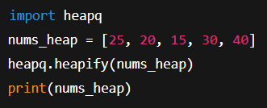
Creating a Heap (Concept)
Converting list to heap
In-place rearrangement
Root as smallest element
Faster than full sorting

Slide 8
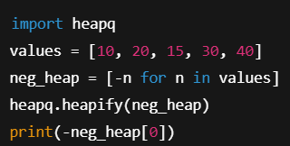
Min-Heap vs Max-Heap Logic
Default min-heap behavior
Value inversion technique
Restoring original values
Use-case comparison

Slide 9
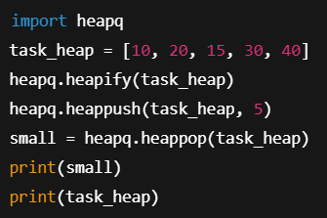
Core Heap Operations
Insert with priority
Remove smallest
Peek root element
Maintaining heap property

Slide 10
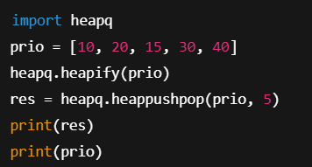
Push & Pop Combined
Single-step optimization
Reduced rebalancing
Performance advantage
Real-time processing

Slide 11
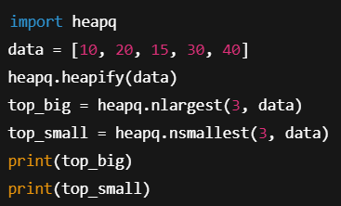
Finding Top-N Elements
nlargest concept
nsmallest concept
Partial sorting logic
Analytics applications

Slide 12
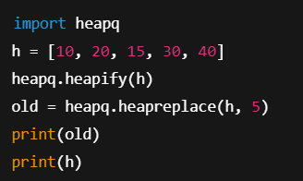
Replace Operation
Pop then push logic
Efficient replacement
Real-time leaderboards

Slide 13
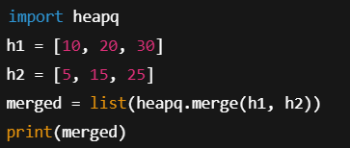
Merge Operation
Merging sorted iterables
Heap-based merging
Streaming data joins

Slide 14
heapreplace vs heappushpop
Order of operations
Decision behavior
Performance difference

Slide 15
Heap vs Full Sorting
Dynamic vs static order
Time complexity comparison
Memory usage intuition

Slide 16
Real-World Industry Use
Job schedulers
Stock order books
Recommendation engines

Slide 17
Common Mistakes
Forgetting min-heap behavior
Wrong value inversion
Modifying heap directly

Slide 18
Best Practices
Use for priority logic
Keep heap small
Combine with tuples

Slide 19
Career Relevance
ML model pipelines
Backend services
Algorithm interviews

Slide 20
Limitations of heapq
No middle access
Not thread-safe
Not full sort

Slide 21
Summary & Key Takeaways
Fast priority access
In-place & efficient
Ideal for dynamic ranking

Slide 22


